Slide 1

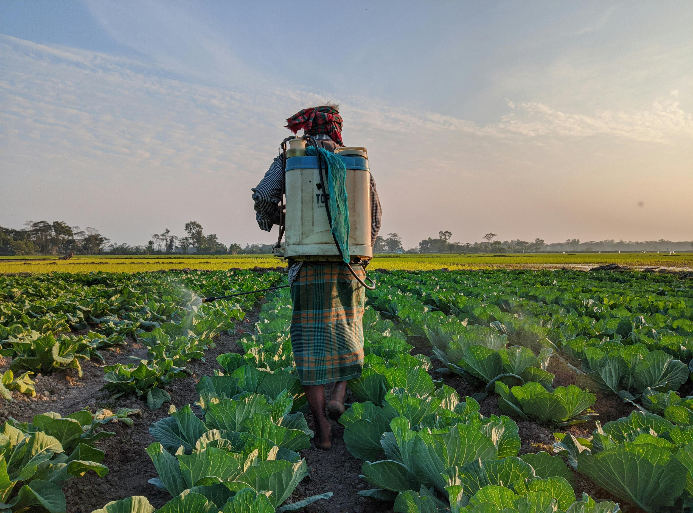

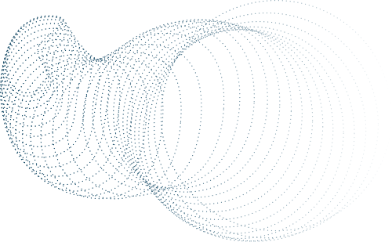

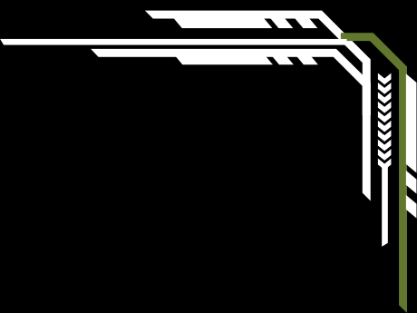
Presented by TECH BROS
THEME 1: CROP PRODUCTION BY DISTRICT
GROUP MEMBERS
SYAMIL ASYRAF BIN MOHD ALI JAAFAR 23001663
AZFAR HARRAZ BIN HALIM 23002503
ABDUL MUHAIMIN BIN AZMAN 23002658
MUHAMMAD FAKHRUL BIN HASSAN 23002457
AHMAD MUKHLIS BIN NORDIN 23002476

Slide 2


CONTENTS
PROBLEM STATEMENT
PREPROCESSING
MODELS
CONCLUSION

Slide 3

PROBLEM STATEMENT
CONTEXT
Farmers often struggle to select the most suitable crop for their soil type, leading to suboptimal yields and inefficient resource use.
Traditional methods rely on manual soil testing and expert consultation, which may be time-consuming or inaccessible in remote areas. Alternatively, we develop a supervised machine learning classification model that recommends the most appropriate crop based on soil and environmental parameters, with the goal of maximizing yield and optimizing resource use.
OBJECTIVES
DATA DESCRIPTION
Build a supervised machine learning model to classify the most suitable crop based on soil properties (e.g., N-P-K levels, pH, moisture).
Incorporate climatic variables such as rainfall and temperature to improve prediction accuracy.
Achieve at least 90% accuracy in predicting crop suitability.
Deploy the model as an interpretable, user-friendly tool accessible to farmers.
Sources: Agricultural databases, soil testing labs, publicly available datasets, or IoT devices.
Features: Nitrogen (N), Phosphorus (P), Potassium (K), pH, temperature, and rainfall.
Target Variable: Crop type (multi-class classification problem).
Success Metrics
Model Performance: Accuracy, precision, recall, and F1-score, especially for imbalanced classes.
Usability Impact: Measurable increase in yield or crop success rate post-implementation.
Adoption: Ease of use and interpretability by end-users (farmers).
Stakeholders
Primary: Farmers, agricultural cooperatives.
Secondary: Agritech startups, researchers, and government agricultural departments.

Slide 4






PREPROCESSING
(CLEANING)
CHECK NULL
CHECK SIMILAR
Machine learning algorithms usually cannot handle null values directly, and they can lead to biased or inaccurate models.
Near-duplicate rows: Rows that are almost the same.
Highly correlated features: Features that provide redundant information.
It can reduce model performance due to multicollinearity.
CHECK OUTLIER
Outliers are data points that are significantly different from other observations. It can skew statistical analyses and negatively affect model performance, especially for algorithms sensitive to distance
CHECK DUPLICATE
CHECK IMBALANCE
Duplicate records mean that the same data entry appears multiple times in the dataset.It can bias the model, especially in classification or regression tasks. They can inflate the model’s confidence and cause overfitting.
Near-duplicate rows: Rows that are almost the same.
Highly correlated features: Features that provide redundant information.
It can reduce model performance due to multicollinearity.

Slide 5


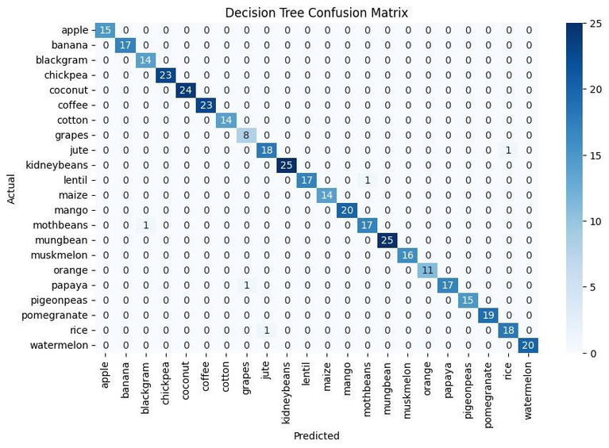
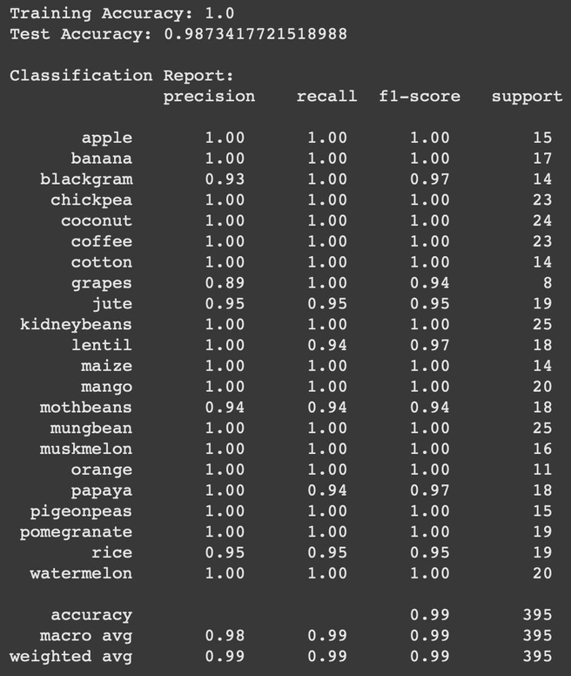
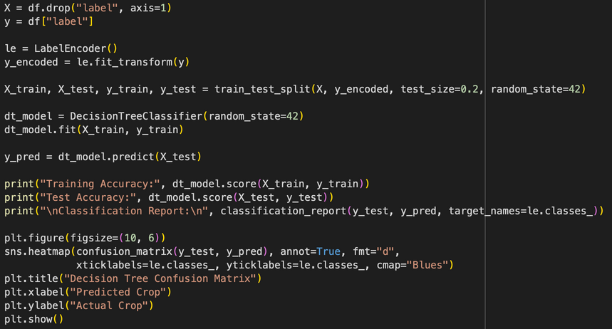

MODELS
DECISION TREE
EXPLANATION
In this project, we use a Decision Tree Classifier from the sklearn library to help us predict the most suitable crop based on soil and weather data.
First, we divide our dataset into two parts using train_test_split from sklearn.model_selection. The two parts are:
Training data – used to teach the model
Test data – used to check how well the model performs on new, unseen data
Next, we use the DecisionTreeClassifier from sklearn.tree. This is a type of classification algorithm that splits the data into branches based on feature values. A model instance is created to begin the training process.
In our model:
We set random_state=42, which is a fixed value for the random number generator. This ensures the results are consistent each time we run the program.
After setting up the model, we train it using the .fit() method. This method takes the training features (X_train) and the training labels (y_train) as inputs. The model learns the relationships between the inputs (like nitrogen, pH, rainfall) and the output (which crop to grow).
Finally, we evaluate the model’s performance on both the training and testing data:
The .score() method calculates the accuracy, which is the percentage of correct predictions made by the model.
The training accuracy which is 100% shows how well the model learned from the data it was trained on.
The test accuracy which is 98.73% on the other hand shows how well the model can predict crops on new, unseen data.
This helps us understand if the model is learning well and making useful predictions, especially for helping farmers decide what crop to grow based on their land’s conditions. ‎
PREDICTION ACCURACY
PERCENTAGE
98.73%

Slide 6

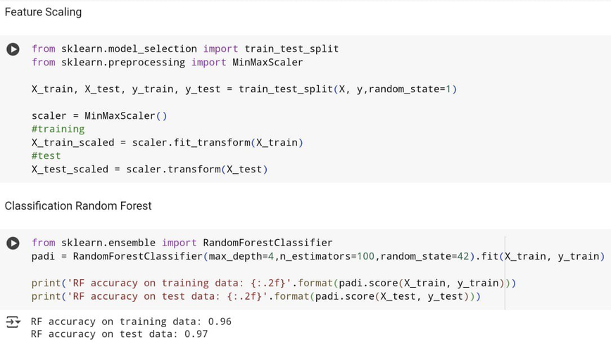
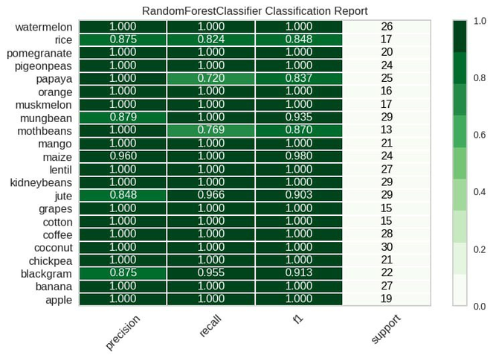
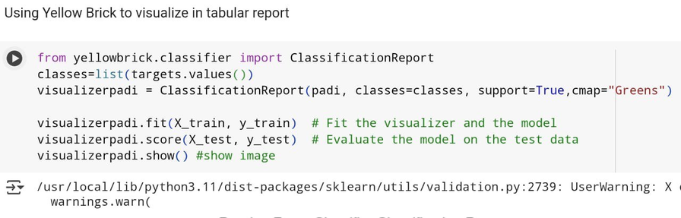
MODELS
RANDOM FOREST
EXPLANATION
Feature scaling = divide the data into 2 part. Training part and Test part using train_test_split from sklearn
Classification Random Forest = import Random class classifier from sklearn, an instance padi is created.
Max depth = 4 means the decision tree depth is 4. We set it 4 to avoid overfitting
Estimators = 100 means the program will create 100 trees
Random_state=42 is a seed for random number generator. It is fixed to ensure the results are reproducable
The .fit() method is then called on the created classifier instance. It takes the training features (X_train) and the corresponding training labels (y_train) as input to learn the relationships between the features and the target variable.
Finally, the code evaluates the performance of the trained model on both the training and testing datasets.
The .score() method calculates the accuracy of the model, which is the proportion of correctly predicted labels. The accuracy is calculated for both the training data (X_train, y_train) and the unseen test data (X_test, y_test). The results are then printed to the console, formatted to two decimal places. The training accuracy tells you how well the model learned the training data, while the test accuracy gives you an idea of how well the model generalizes to new, unseen data.
By using yellowbrick class, we visualize the data in a table format
KEY POINT
Precision : Measures the accuracy of positive predictions.
Recall : Indicates how many actual positives were correctly identified.
F1-Score : Balances precision and recall into a single score.
Support : Shows the number of samples for each class
PREDICTION ACCURACY
PERCENTAGE
96.0%

Slide 7
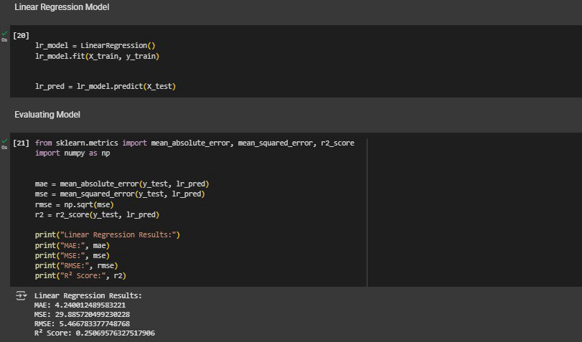
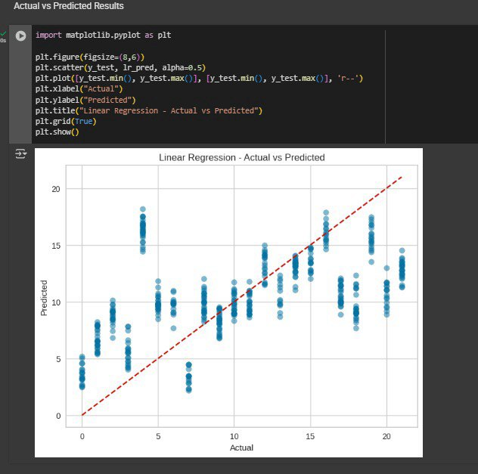
MODELS
LINEAR REGRESSION
EXPLANATION
Model Training:
We used the LinearRegression() model from sklearn.linear_model.
The model was trained using X_train (input features like rainfall, temperature, fertilizer used, etc.) and y_train (target values such as crop yield or production amount).
Model Evaluation:
We used common evaluation metrics to check how well the model is predicting crop yield:
MAE (Mean Absolute Error): average of errors
MSE (Mean Squared Error): squares the errors, penalizing large ones more
RMSE (Root MSE): gives error in the same units as the output
R² Score: how well the model explains the variation in crop yield
Visualization:
We plotted the actual vs predicted values to see how close the predictions are to the real crop yields.
The red dashed line represents a perfect prediction line (where predicted = actual).
MAE: 4.24 MSE: 29.89
RMSE: 5.47 R² Score: 0.25

Slide 8
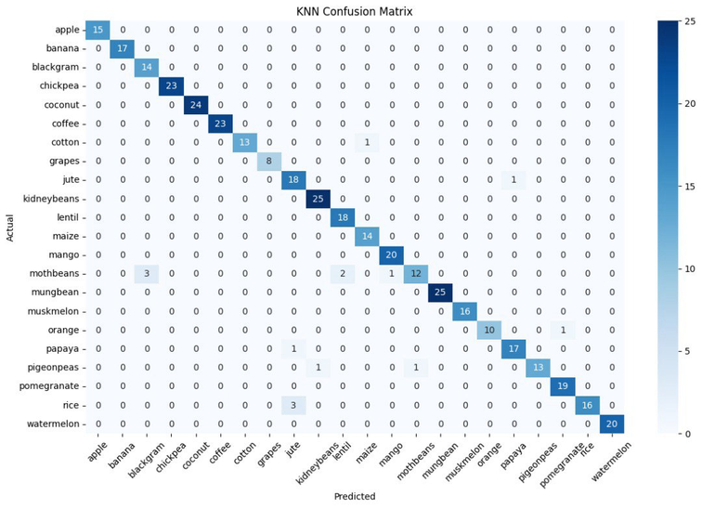
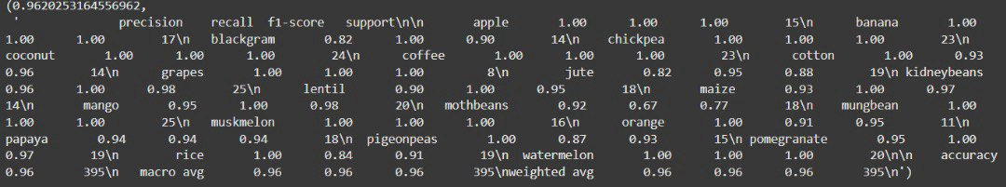
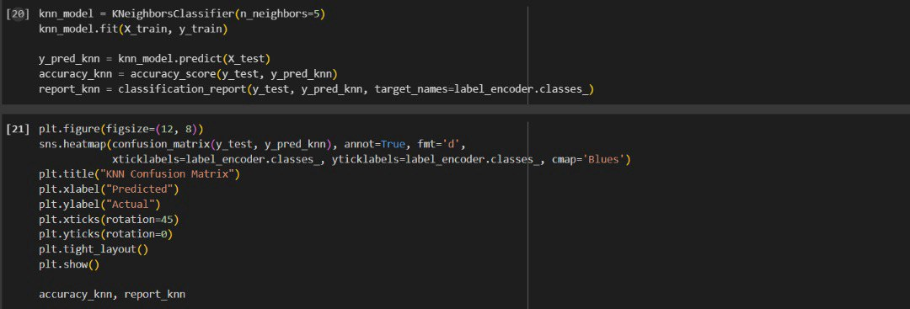
MODELS
KNN
EXPLANATION
For the K-Nearest Neighbors (KNN) Classifier from the sklearn library similar to most of the model in this project so far.
we use division of our dataset like before
The scaling of the data using StandardScaler from sklearn.preprocessing is important for KNN, because it uses distance between data points to make decisions, and features like rainfall and temperature have very different units. Scaling puts everything on the same level.
We also encode the target labels (the crop names) into numbers using LabelEncoder. This allows the model to work with the crop names in numeric form.
Next, we use the KNeighborsClassifier from sklearn.neighbors. This algorithm looks at the k closest data points to a new input and predicts the most common class among them. In our case, it helps choose the best crop based on similar soil and weather conditions.
We set n_neighbors(k)=5, which means the model looks at the 5 nearest neighbors when making predictions.
After setting up the model, we train it using the .fit() method. This method takes the training features (X_train) and the training labels (y_train) as inputs. The model does not "train" in a traditional sense—it simply stores the training data for later comparison.
Finally, we evaluate the model’s performance on the test data:
The accuracy_score() function calculates the accuracy, which is the percentage of correct predictions made by the model.
The classification_report() gives more detail, showing how well the model predicted each specific crop.
A confusion matrix is also used to see exactly where the model made correct or incorrect predictions.
Our KNN model achieved an accuracy of around 96%, which means it was able to predict the correct crop in most case
PREDICTION ACCURACY
PERCENTAGE
96.2%

Slide 9
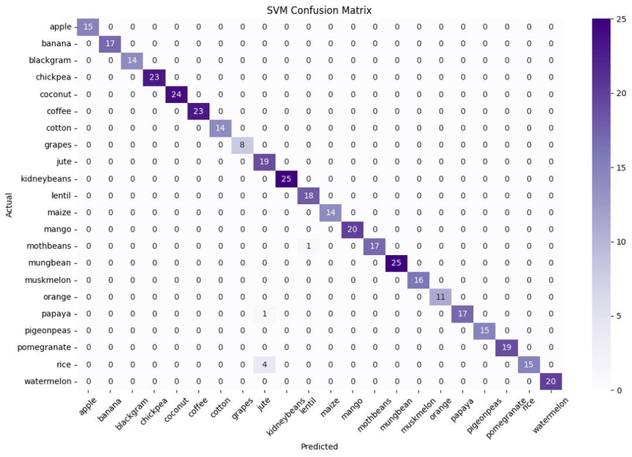
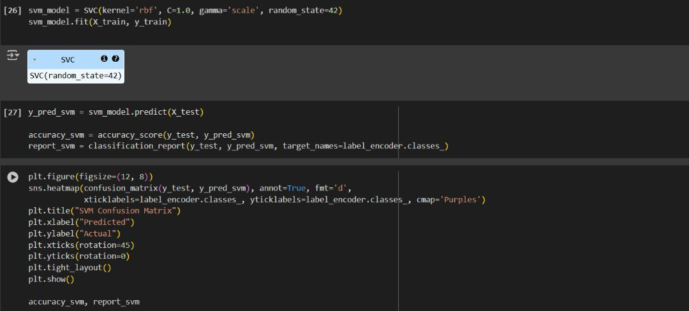
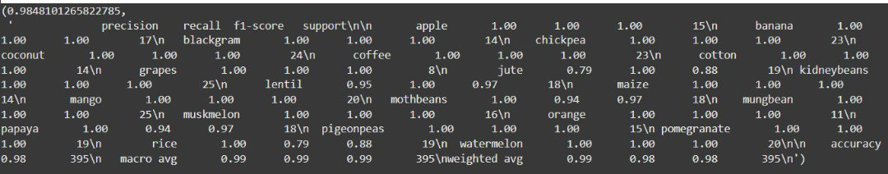
MODELS
SVM
EXPLANATION
For SVC (Support Vector Classifier), we use class from sklearn.svm to create our model.
We set:
kernel='rbf' – a popular radial basis function kernel that works well for non-linear data.
C=1.0 – this controls the trade-off between having a smooth decision boundary and classifying training points correctly.
gamma='scale' – automatically sets the gamma parameter based on input features.
random_state=42 – ensures our results are reproducible.
Then, we train the model using the .fit() method with our training features (X_train) and labels (y_train).
As per our other model, we evaluate the model’s performance using:
.predict() – to predict crops for the test set.
accuracy_score() – shows the percentage of correct predictions.
classification_report() – gives detailed performance per crop.
confusion_matrix() – a table showing which crops were predicted correctly or incorrectly.
The final result for the SVM model Accuracy: 98.19%
Most crops are predicted with nearly perfect precision and recall.
PREDICTION ACCURACY
PERCENTAGE
98.48%

Slide 10




CONCLUSION
In short, we have implemented a complete machine learning pipeline — from data preprocessing, feature selection, and model training to evaluation — using real-world agricultural datasets. Through this process, we assessed multiple algorithms, fine-tuned hyperparameters, and validated our models to ensure reliability and robustness. Our analysis enabled us to uncover patterns and trends in crop yield across districts, which could be valuable for stakeholders such as policymakers, farmers, and agribusinesses. One key finding was that machine learning models can predict crop production with considerable accuracy when supplied with clean and well-structured data. This opens opportunities for scalable, data-informed agricultural systems that respond proactively to changes in environment, demand, and land use. By comparing traditional models with AutoML techniques like Auto-Sklearn, we further demonstrated the potential for automated systems to support agricultural forecasting with minimal human intervention.
QUICK RECAP
5 DIFFERENT MODELS
PREPROCESSING(CLEANING)
DECISION TREE
RANDOM FOREST
CHECK NULL
CHECK SIMILAR
LINEAR REGRESSION
KNN
CHECK DUPLICATE
CHECK IMBALANCE
CHECK OUTLIER
SVM

